Slide 1
The Exhaustion of Natural Resources

Slide 2
What are Natural Resources ?
Natural resources are resources that exist without any actions of humankind. On Earth , it includes sunlight , water , atmosphere , land(includes all minerals) along with all vegetation , crops , and animal life.

Slide 3
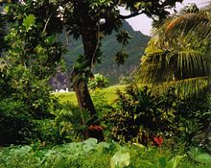
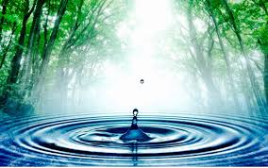
Some Important Natural Resources
Forest provides timber for humans, food, water and shelter for the flora and fauna tribes and animals. The nutrient cycle between organisms form food chains and biodiversity of species.
Water is an essential resource needed to survive everyday life. Historically, water has had a profound influence on a nation's prosperity and success around the world. Groundwater is water that is in saturated zones underground, the upper surface of the saturated zone is called the water table.

Slide 4
How are natural resources useful for Human Life ?
Natural resources are available to sustain the very complex interaction between living things and non-living things.

Slide 5
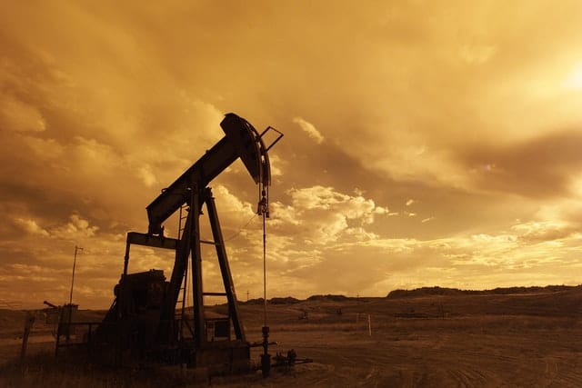
Impact of depletion in natural resources
Oil is an essential commodity in manufacturing, planting, mining, and transportation among many activities, and its depletion would be devastating. The adverse effects of oil depletion include the fall of the business, the high cost of living in developing countries, and uncertainty in the transport sector.

Slide 6
Causes for depletion in natural resources
Overpopulation
Overconsumption and waste.
Deforestation and the Destruction of Ecosystems leading to loss of biodiversity.
Mining of Minerals and Oil.
Technological and Industrial Development.
Erosion.
Pollution and Contamination of resources.

Slide 7

You can make a big difference

